Slide 1

Database Solutions for Big Bear Zoo
May
2021
Presenters:
Sean Blanchard Roxanna Pinotti

Slide 2
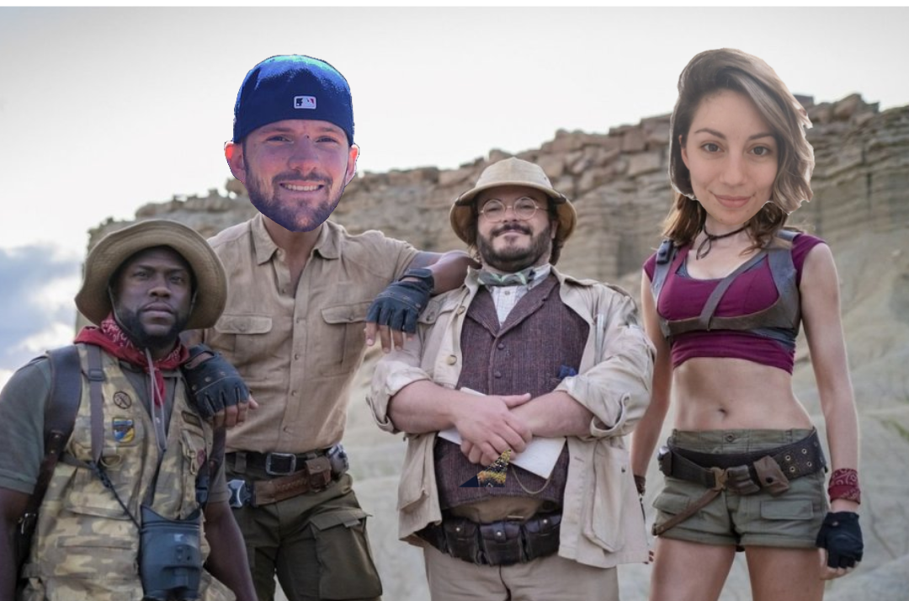
Who are we?
Who is helping the zoo with their database management system?
ROXANNA PINOTTI
I am one of the park managers of the zoo with a background in IT and animal hospitality. My revelation to create a useful database occurred when I looked into the eyes of a tortoise who I felt was communicating with me telepathically to build something that will help all animals in the zoo. This has grown to include the customers of the park who help fund our rescue efforts.

Slide 3

What is the problem?
How is the lack of a coherent DBMS problematic for the zoo? Why?
The largest problem the zoo has faced with not having a comprehensive database, is the lack of organization with keeping track of the rehabilitated animals and their feeding schedules.
This then snowballs into the problem we will face with assigning these tasks to the zoo staff, via staffing issues and scheduling.
Inadvertently, the health of the zoo will decline due to lower ticket sales which in turn affects the animals needing to be rehabilited at the facility.

Slide 4

What is our solution?
A good DBMS system can help manage the business’ critical data safely and securely.
We will be creating a database large enough to track not only the animals in the park, but the employees who will be administering the care of these animals.
This will provide the more streamlined management of human resources which will help us save money and time.
We will also be able to manage who comes in and out of the zoo via ticket and membership purchases.
Overall, the zoos primary concern is of the animals and our goal is to constantly increase efficiency of care through the maintentance of employees and visitors.
What solutions can we offer the zoo, and why is it the best one?

Slide 5


How does our application work?
What are the features?
How does the user interact with it?
The application is going to be user friendly, without the need for an extensive technical background.
Although basic, this will not take away from the DBMS’s capabilities.
Cashiers will be able to enter customer’s personal information to be stored in the zoo’s database.
Tickets may be purchased after entering requested information.
Employees will be able to change the species’ feeding schedule.
We may delete an employee from a database for any reason.
The user interacts with the database via a GUI application which pops up a window prompting the user to input or modify information. They may enter information and purchase tickets.

Slide 6




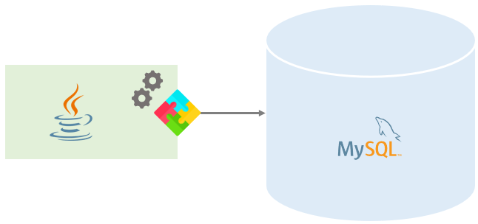
How is our application and database implemented?
What technologies did we use?

Slide 7

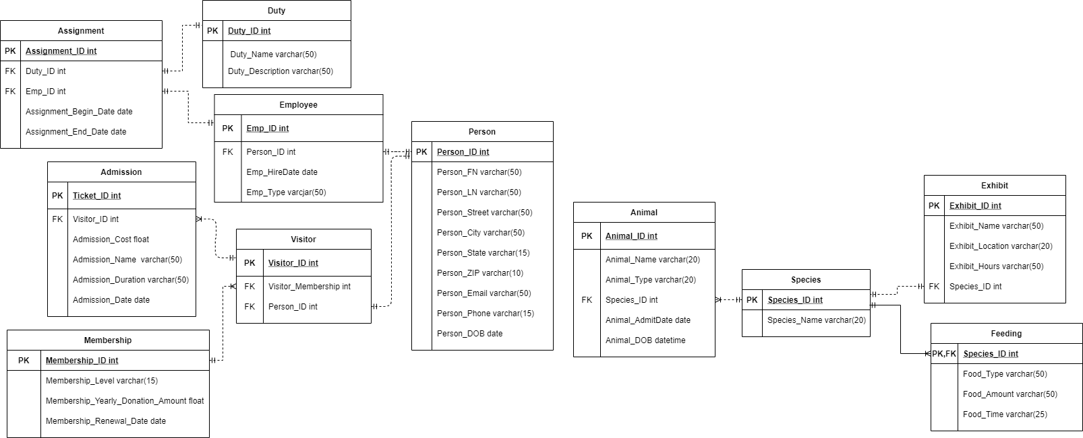
How is our application and database implemented?
Database schema and ERD diagram

Slide 8
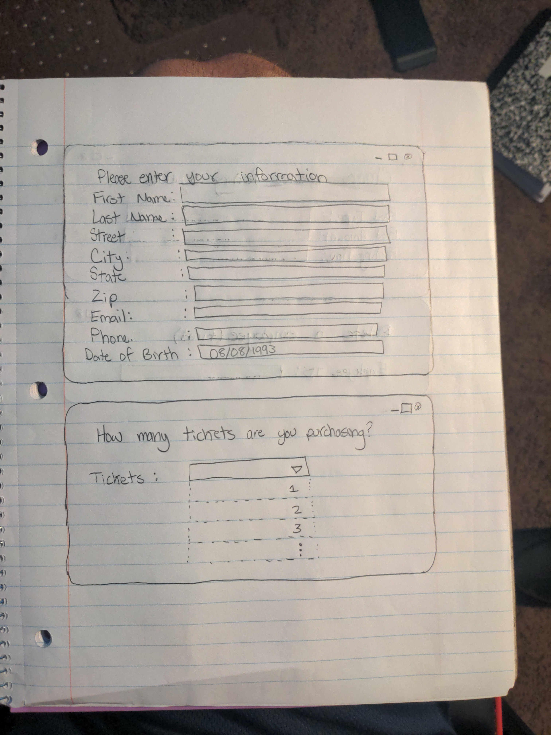
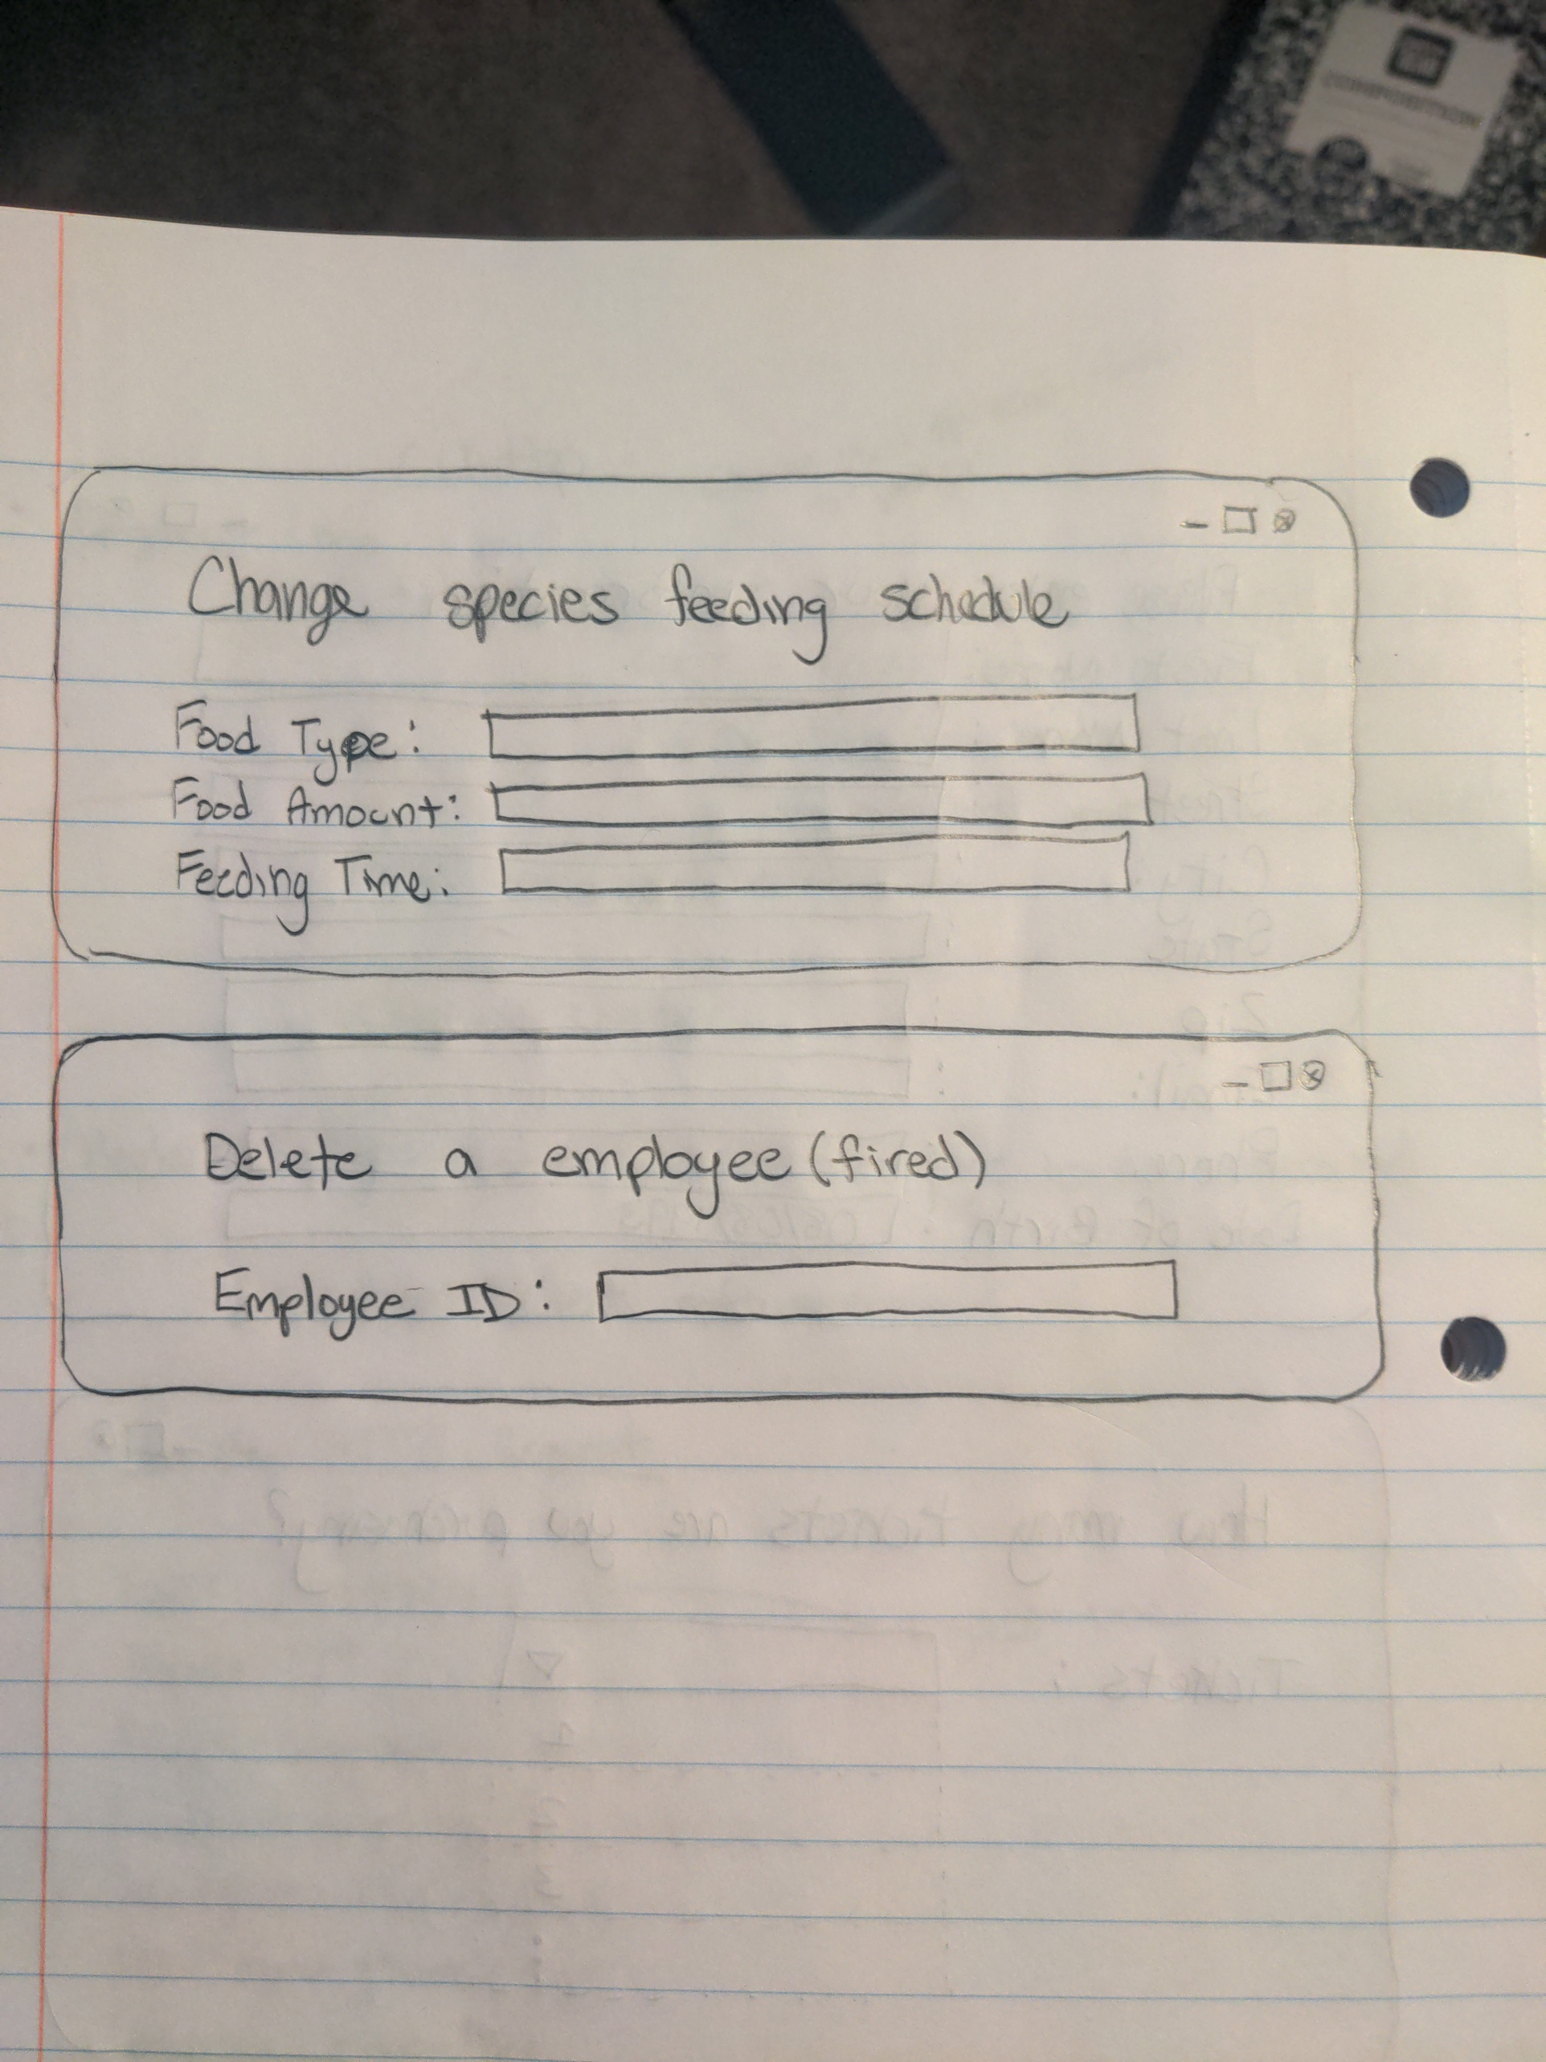
How is our application and database implemented?
Rough UI Prototypes

Slide 9

How is our application and database implemented?
Views possible
How many ticket sales on certain dates
How many different species held at the zoo
List of all animal names at the park
List of exhibit hours
Admission cost

Slide 10

How is our application and database implemented?
Triggers possible
Before a ticket purchase can be made, the database will check if the purchaser is over 18 y/o.
Before adding a new person to the database, it will check to make sure there are no duplicate entries.
After deleting an employee, they too will be deleted from the Persons table.

Slide 11

How is our application and database implemented?
Queries possible
Find each duty given in the past year
Number of employees in the database
Number of animals in the database
Which species eats what food
How many tickets were sold the day prior
Returns people’s names in the database that start with ‘A’
The number of species in the database
List the name of all the species in the database
Returns the exhibit hours for bears
Returns the exhibit location for bears
Returns the day of the last administered animal in the database
A given person’s ID number will return their first and last name

Slide 12




THANK YOU!
Sean Blanchard | Roxanna Pinotti

